Slide 1
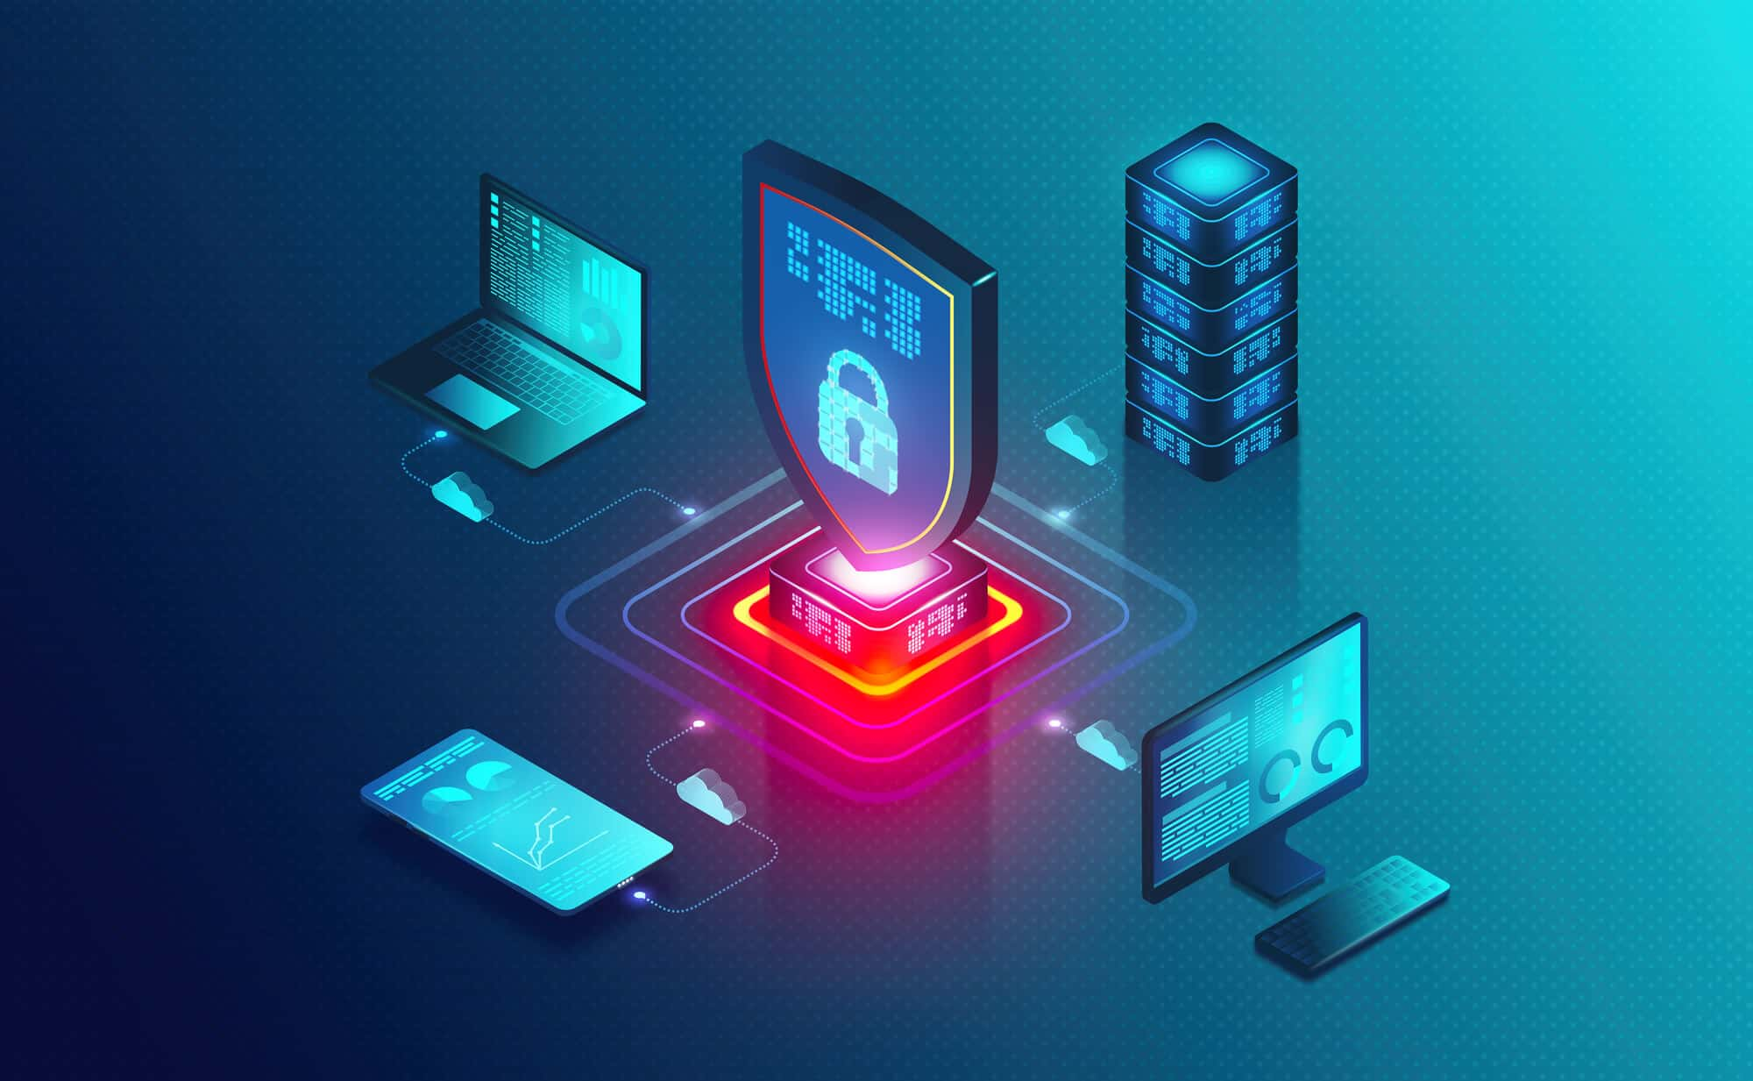
DAY 01
Introduction To
CyberSecurity
Foundations of digital defense — threats, vulnerabilities & risk

Slide 2
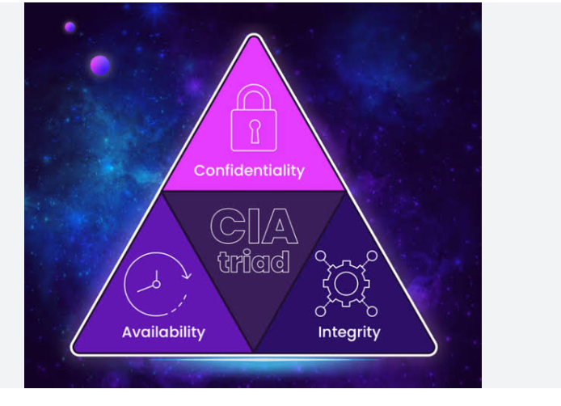
CyberSecurity
CyberSecurity is the protection of systems, networks, and servers from cyber threats such as hacking, digital attacks, and unauthorized access.
EXAMPLES
1
Protecting social media from hacking
2
Preventing malware and viruses
3
Protecting website and organization data
4
Protecting bank information
Introduction to CyberSecurity • Day 01
2

Slide 3
Types Of Security
1
2
3
Network Security
Application Security
Information Security
Protects computer networks from cyber attacks.
Protects websites and applications from hackers.
Protects sensitive data from unauthorized access.
4
5
6
Cloud Security
Ethical Hacking (Red Team)
Blue Team (Defensive Security)
Protects cloud platforms and online storage.
Tests systems to find security weaknesses.
Defends systems by monitoring and responding to cyber attacks.
Introduction to CyberSecurity • Day 01
3

Slide 4
Importance
1
2
3
4
Banking
Shopping
Social Media
Business System
Introduction to CyberSecurity • Day 01
4

Slide 5
Types Of Hackers
1
White Hat Hackers
Ethical hackers who protect systems by finding and fixing security vulnerabilities.
2
Black Hat Hackers
Criminal hackers who steal data or damage systems for personal gain.
3
Gray Hat Hackers
Hackers who may hack without permission but usually report vulnerabilities afterward.
4
Script Kiddies
Beginners who use pre-made hacking tools with little knowledge.
Introduction to CyberSecurity • Day 01
5

Slide 6
Types Of Hackers (Continued)
5
Green Hat Hackers
New learners who are developing their hacking skills.
6
Red Hat Hackers
Hackers who aggressively fight against Black Hat hackers.
7
Hacktivists
Hackers who attack systems for political or social causes.
8
Nation-State Hackers
Hackers who work for governments to conduct cyber espionage or attacks.
9
Malware Developers
Hackers who create malicious software such as viruses or ransomware.
Introduction to CyberSecurity • Day 01
6

Slide 7

CIA Triads
1
Confidentiality
Ensure that only authorized users can access the data.
2
Integrity
Ensure that data is not changed during transmission.
3
Availability
Information is available and accessible to authorized users when needed.
Introduction to CyberSecurity • Day 01
7

Slide 8
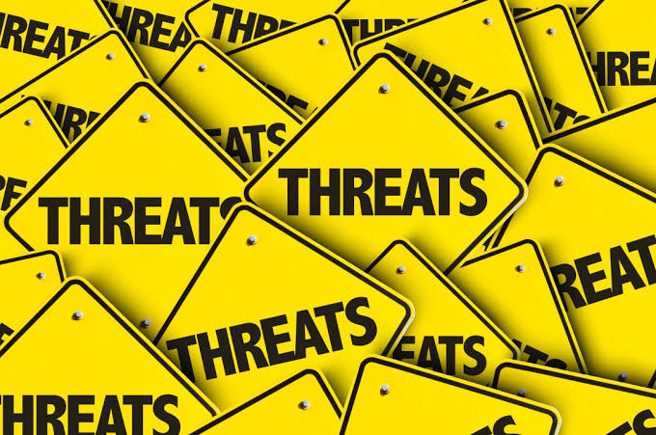
Threat
A threat is something that has the potential to damage, disrupt, steal, or gain unauthorized access to a computer system, network, or data.
EXAMPLES
•
Malware
•
Phishing
•
Ransomware
•
Man in the Middle
•
DDoS
•
Inside Threat
Introduction to CyberSecurity • Day 01
8

Slide 9
Real World Example
1
2
3
4
→
→
→
A hacker sends a phishing email to an employee.
The employee clicks the malicious link.
The attacker steals the login credentials.
The company data is compromised.
The phishing email is the threat.
Introduction to CyberSecurity • Day 01
9

Slide 10
Key Points
A threat is a potential danger.
✓
It targets systems, networks, or data.
✓
It exploits vulnerabilities.
✓
It can lead to data theft, financial loss, or service disruption.
✓
Introduction to CyberSecurity • Day 01
10

Slide 11
Attack Surface
An attack surface is the total number of entry points where an attacker can try to gain unauthorized access to a system, network, or application.
EXAMPLES
•
Website
•
Email Server
•
VPN
•
Cloud Storage
•
Employee Laptops
•
Wi-Fi Network
Introduction to CyberSecurity • Day 01
11

Slide 12
Types Of Attack Surface
1
Network Attack Surface
Entry points connected to the network, such as open ports, VPN, Wi-Fi, firewalls, routers, and remote desktop.
2
Software Attack Surface
Weaknesses in software or applications, such as bugs, SQL injection, XSS, and unpatched software.
3
Human Attack Surface
People who become entry points through phishing, weak passwords, or social engineering.
4
Physical Attack Surface
Physical access to devices, such as stolen laptops, unlocked server rooms, and lost USB drives.
Introduction to CyberSecurity • Day 01
12

Slide 13
Real World Example
1
2
3
4
→
→
→
A company exposes a website, VPN, and cloud database online.
An attacker scans and identifies these entry points.
The attacker targets the VPN, since it uses a weak password.
The attacker gains unauthorized access to the network.
The website, VPN, and cloud database together form the attack surface.
Introduction to CyberSecurity • Day 01
13

Slide 14
How To Reduce The Attack Surface
✓
Close unused network ports
✓
Remove unnecessary software
✓
Disable unused services
✓
Apply security patches regularly
✓
Use strong passwords and MFA
✓
Train employees to recognize phishing
Introduction to CyberSecurity • Day 01
14

Slide 15
Key Points
An attack surface is the total number of entry points an attacker can target.
✓
It includes network, software, human, and physical entry points.
✓
A larger attack surface means more opportunities for attackers.
✓
Reducing the attack surface is a key part of strong cyber defense.
✓
Introduction to CyberSecurity • Day 01
15

Slide 16
Vulnerability
A vulnerability is a weakness or flaw in a system, network, application, or process that can be exploited by a threat to gain unauthorized access or cause damage.
EXAMPLES
Weak Passwords
Outdated Software
Unpatched Operating System
!
!
!
Misconfigured Firewall
Open Ports
Poor Access Control
!
!
!
Introduction to CyberSecurity • Day 01
16

Slide 17
Real World Example
1
2
3
4
→
→
→
A company uses "123456" as an administrator password.
The weak password is the vulnerability.
A hacker guesses the password.
The attacker gains unauthorized access to the system.
The weak password is the vulnerability.
Introduction to CyberSecurity • Day 01
17

Slide 18
Prevention
✓
Use strong passwords
✓
Update software regularly
✓
Install security patches
✓
Enable Multi-Factor Authentication (MFA)
✓
Configure firewalls properly
✓
Perform regular vulnerability assessments
Introduction to CyberSecurity • Day 01
18

Slide 19
Key Points
A vulnerability is a weakness, not an attack.
✓
Threats exploit vulnerabilities.
✓
Reducing vulnerabilities improves security.
✓
Regular updates and security best practices help prevent exploitation.
✓
Introduction to CyberSecurity • Day 01
19

Slide 20
Risk
A risk is the possibility that a threat will exploit a vulnerability and cause harm, damage, or loss to an organization.
EXAMPLES
Data Breach
Financial Loss
Identity Theft
▲
▲
▲
System Downtime
Reputation Damage
Loss of Confidential Data
▲
▲
▲
Introduction to CyberSecurity • Day 01
20

Slide 21
Real-World Example
A company uses a weak password.
THREAT
VULNERABILITY
RISK
Hacker
Weak Password
Hacker gains unauthorized access and steals company data.
The possibility of data theft is the risk.
Introduction to CyberSecurity • Day 01
21

Slide 22
Risk Mitigation
✓
Use strong passwords
✓
Enable Multi-Factor Authentication (MFA)
✓
Update software regularly
✓
Install security patches
✓
Train employees on cybersecurity awareness
✓
Perform regular security assessments
Introduction to CyberSecurity • Day 01
22

Slide 23
Key Points
Risk is the chance of damage or loss.
✓
Risk exists when a threat exploits a vulnerability.
✓
Organizations reduce risk through security controls and best practices.
✓
Risk cannot always be eliminated, but it can be managed.
✓
Introduction to CyberSecurity • Day 01
23

Slide 24
Threat vs Vulnerability vs Risk
Threat
Vulnerability
Risk
A potential danger that can cause harm.
A weakness that can be exploited.
The possibility of damage when a threat exploits a vulnerability.
It is the attacker or harmful event.
It is the security weakness.
It is the potential loss or impact.
Can exploit vulnerabilities.
Can be exploited by threats.
Occurs because of threats and vulnerabilities.
Example: Hacker, Malware, Phishing
Example: Weak Password, Outdated Software, Open Port
Example: Data Breach, Financial Loss, System Downtime
Introduction to CyberSecurity • Day 01
24

